Slide 1

VIRTUAL INTERNSHIP 6.0 – INFOSYS SPRINGBOARD
Smart Home Energy Management System
Presented by: Mounika
Under the Guidance of Dr. T. Premalatha

Slide 2

Module 1 Overview: Authentication Module
Purpose
Validate user identity
Manage logins and roles
Ensure secure access
Main Components
AuthController
AuthService
UserRepository
User (Model)
Key Functions
User login
Password validation
Role-based access
Outputs
Login success / error response

Slide 3


Module 2 Overview: Smart Device Management
Purpose
Manage smart home devices
Control ON / OFF states
Maintain device status
Main Components
DeviceController
DeviceService
DeviceRepository
Device (Model)
Key Functions
Add / Update / Delete devices
Control device operations
Outputs
Real-time device status updates
Device list for dashboard integration

Slide 4
Module 3 Overview: Real-Time Energy Tracking
Meaning
Problems Addressed
Purpose
Tracks energy usage per device in real-time, providing granular insights into consumption patterns.
Resolves lack of visibility into energy usage and addresses concerns regarding high electricity bills.
Enables real-time monitoring of energy consumption and maintains historical usage logs for analysis.
System Architecture
Main Components
Data flows from Smart Devices → Backend Processing → Interactive Energy Dashboard.
EnergyTrackingController
EnergyTrackingService
UsageRepository
UsageLog (Model)

Slide 5

Pseudocode: Core Logic Simplification
Simplified pseudocode representing the foundational logic for authentication, device control, and energy tracking, crucial for the Smart Home Energy Management System.
Device & Energy Logic
// Device ON/OFF Control function controlDevice(deviceId, state, userId): if AuthenticationService.isAuthorized(userId, deviceId): device = DeviceRepository.findById(deviceId) device.setState(state) EnergyTrackingService.recordUsage(deviceId, state, timestamp) return "Device State Updated" else: return "Unauthorized Access" // Energy Usage Recording function recordUsage(deviceId, state, timestamp): usageLog = new UsageLog(deviceId, state, timestamp) UsageRepository.save(usageLog)
Authentication Logic
// Login & Role Check
function authenticateUser(username, password):
user = UserRepository.findByUsername(username)
if user and user.password == password:
if user.hasRole('HOME_OWNER') or user.hasRole('FAMILY_MEMBER'):
return "Login Success", user.role
else:
return "Unauthorized Role"
else:
return "Invalid Credentials"

Slide 6


Integrated System Flow: Modules 1, 2 & 3
User
Authentication
Smart Device Control
Energy Tracking
Secure Access
Device Interaction
User authentication is the gateway, ensuring only authorized individuals can access and manage smart home devices.
Authenticated users can effortlessly control various smart devices, from lighting to climate control.
Actionable Data
Every device action generates valuable energy data, empowering users with insights for optimization and savings.

Slide 7

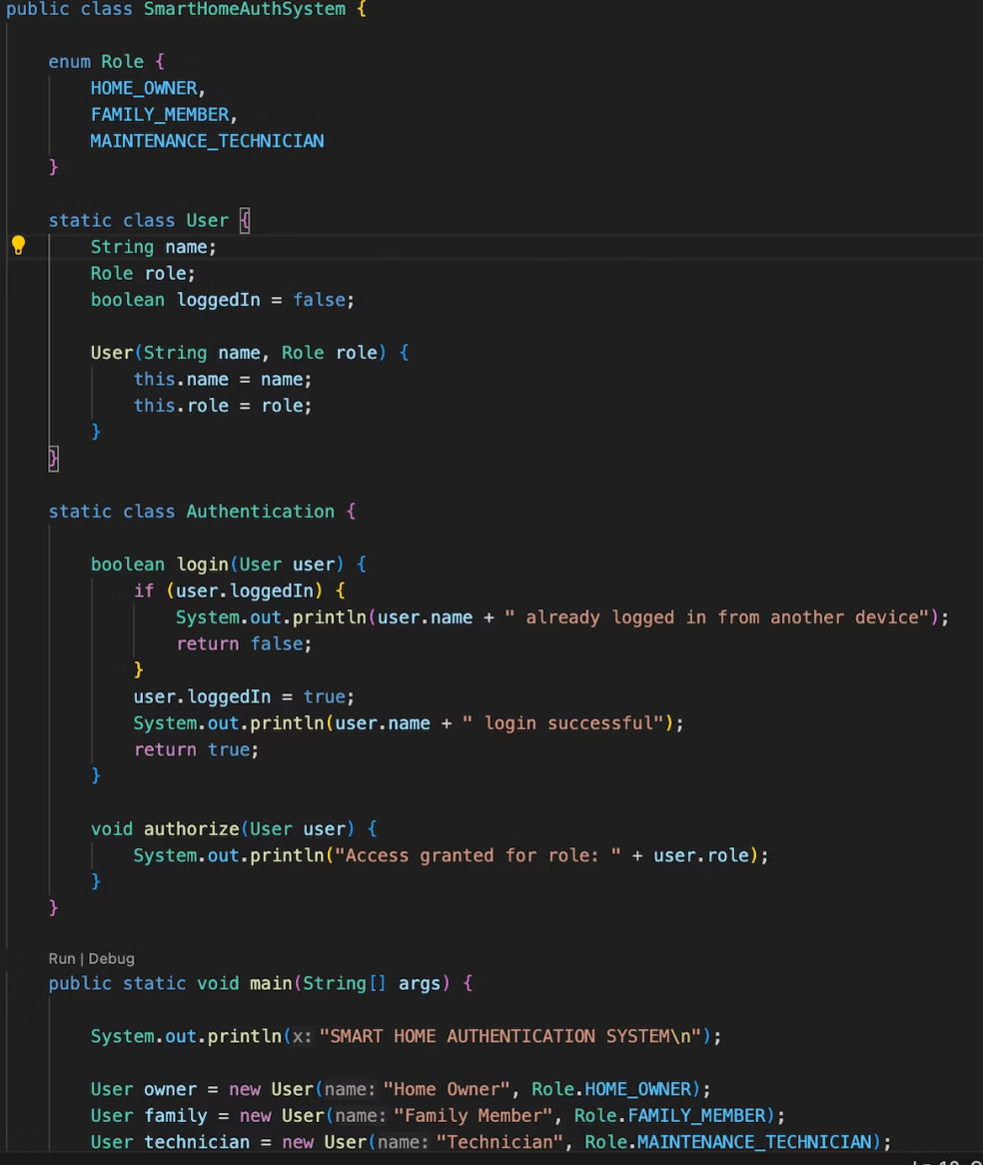
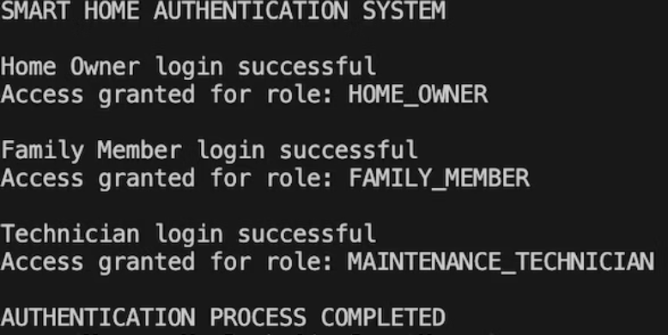
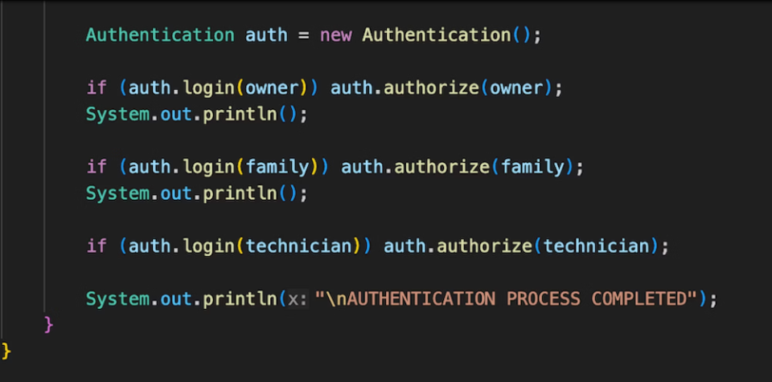
Technical Implementation: Module 1 Code
The Authentication Module underpins the system's security, implementing robust role-based access control and a secure login mechanism.
// SmartHomeAuthSystem: Role-Based Access Control
Key Aspects
Role-based Access: Differentiates user privileges based on defined roles.
Secure Authentication: Ensures validated user access through robust login flows.
User Management: Provides the foundation for managing user profiles and permissions effectively.
OUTPUT:

Slide 8

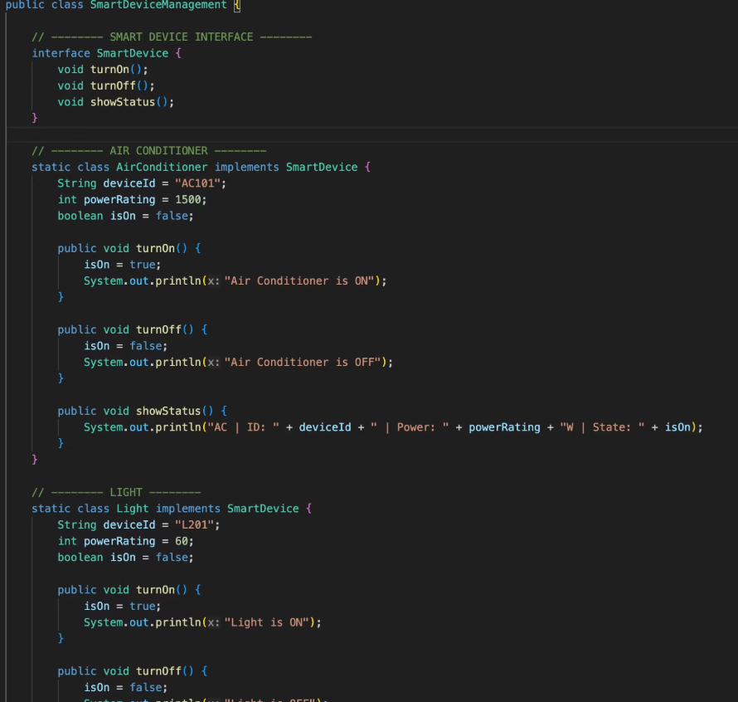
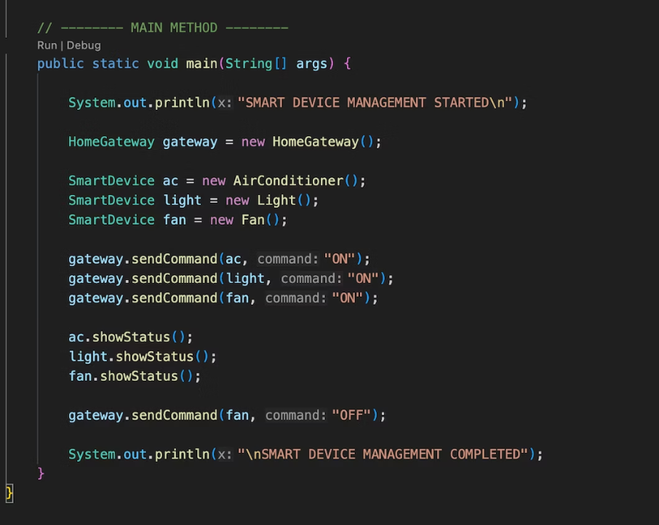
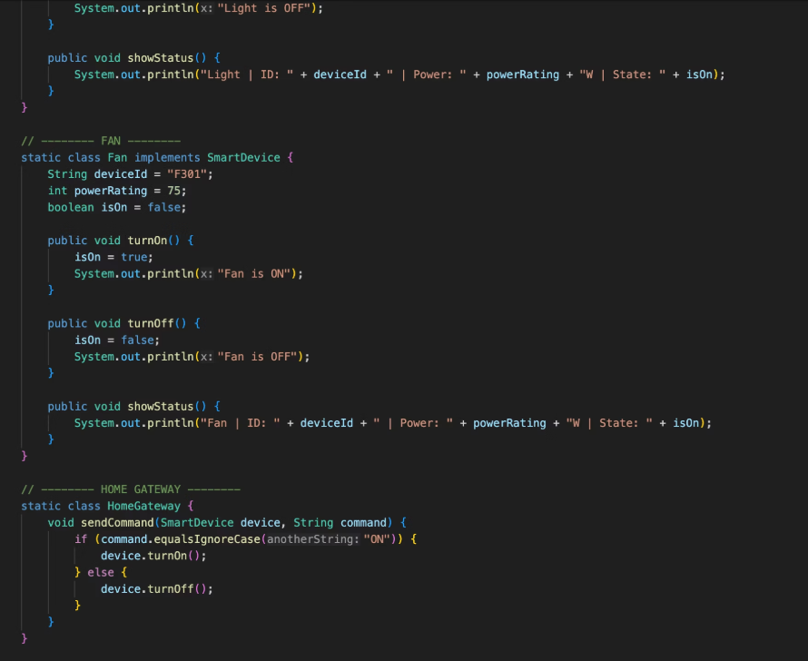
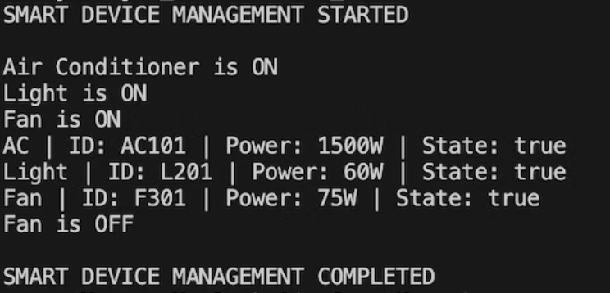
Technical Implementation: Module 2 Code
The Smart Device Management Module provides a flexible and extensible framework for controlling diverse smart home devices.
// Smart Device Management
Device Control
Unified Interface: Standardized control through the SmartDevice interface.
Centralized Management: HomeGateway acts as the hub for all device interactions.
Extensible Design: Easily integrate new device types with minimal code changes.
OUTPUT:

Slide 9
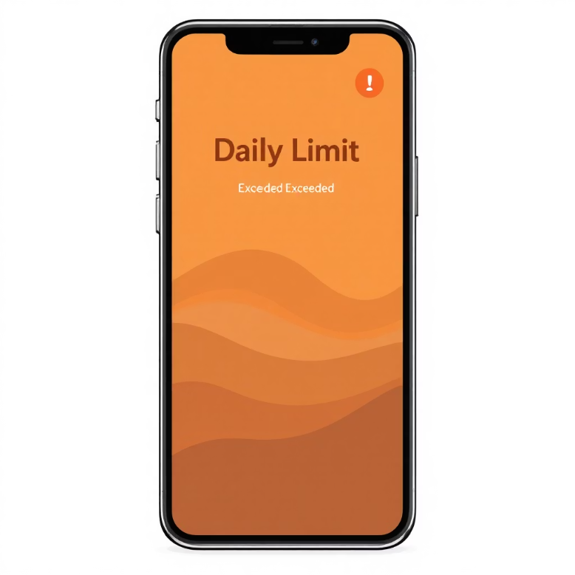
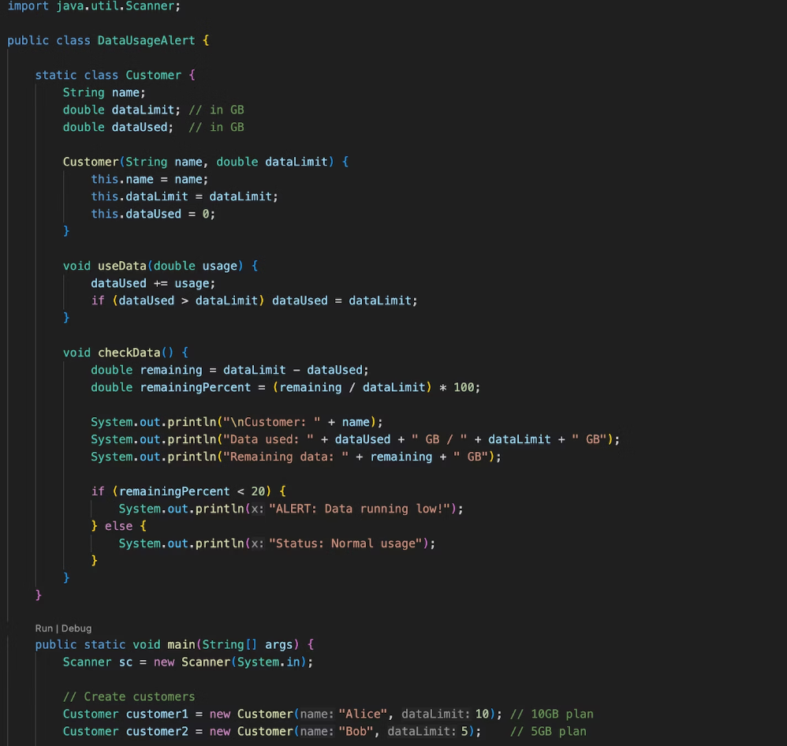
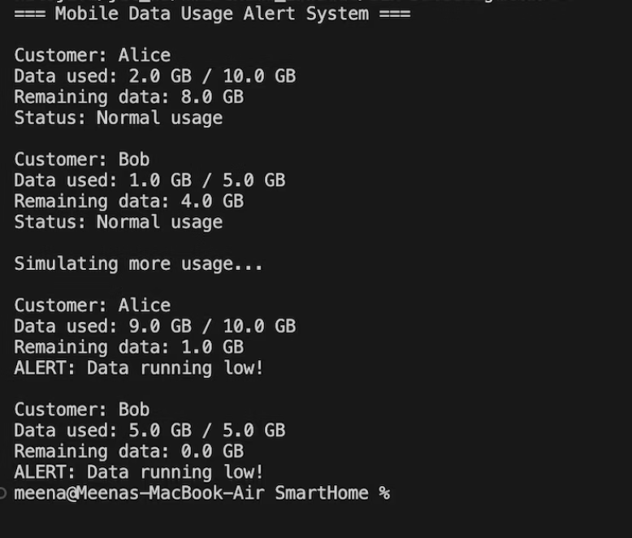
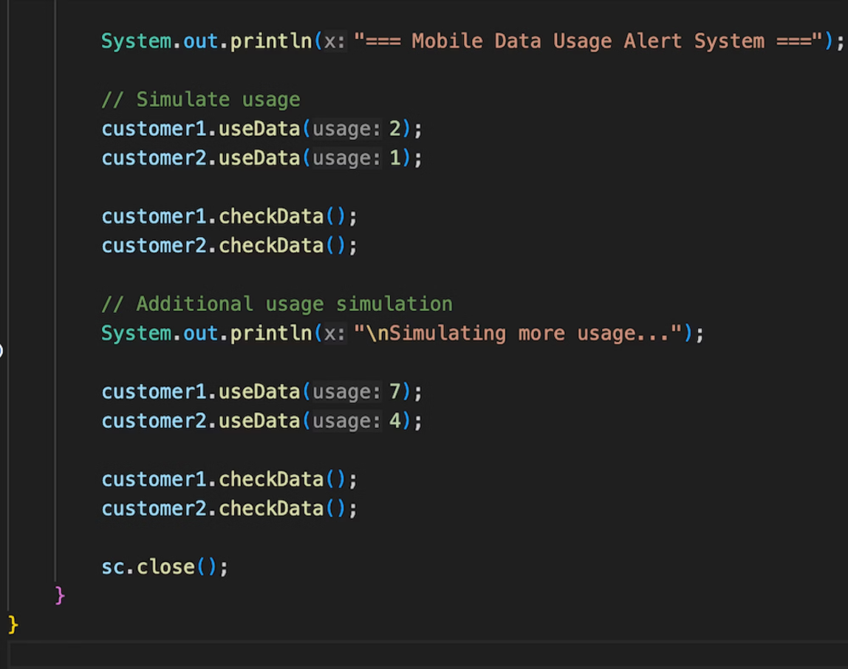
Technical Implementation: Module 3 Code
The Energy Tracking Module provides critical insights and proactive alerts for efficient energy usage.
// Mobile Data / Data Usage Alert System
Output:

Slide 10

Thank You
For your valuable time and attention.

